Slide 1
All Things Weather
Cultural exchange program

Slide 2
The Sun
The Sun rises in the east…
…and sets in the west
The sun’s Rays provide most of Earth’s heat

Slide 3
Precipitation
(Most places only get rain)

Slide 4
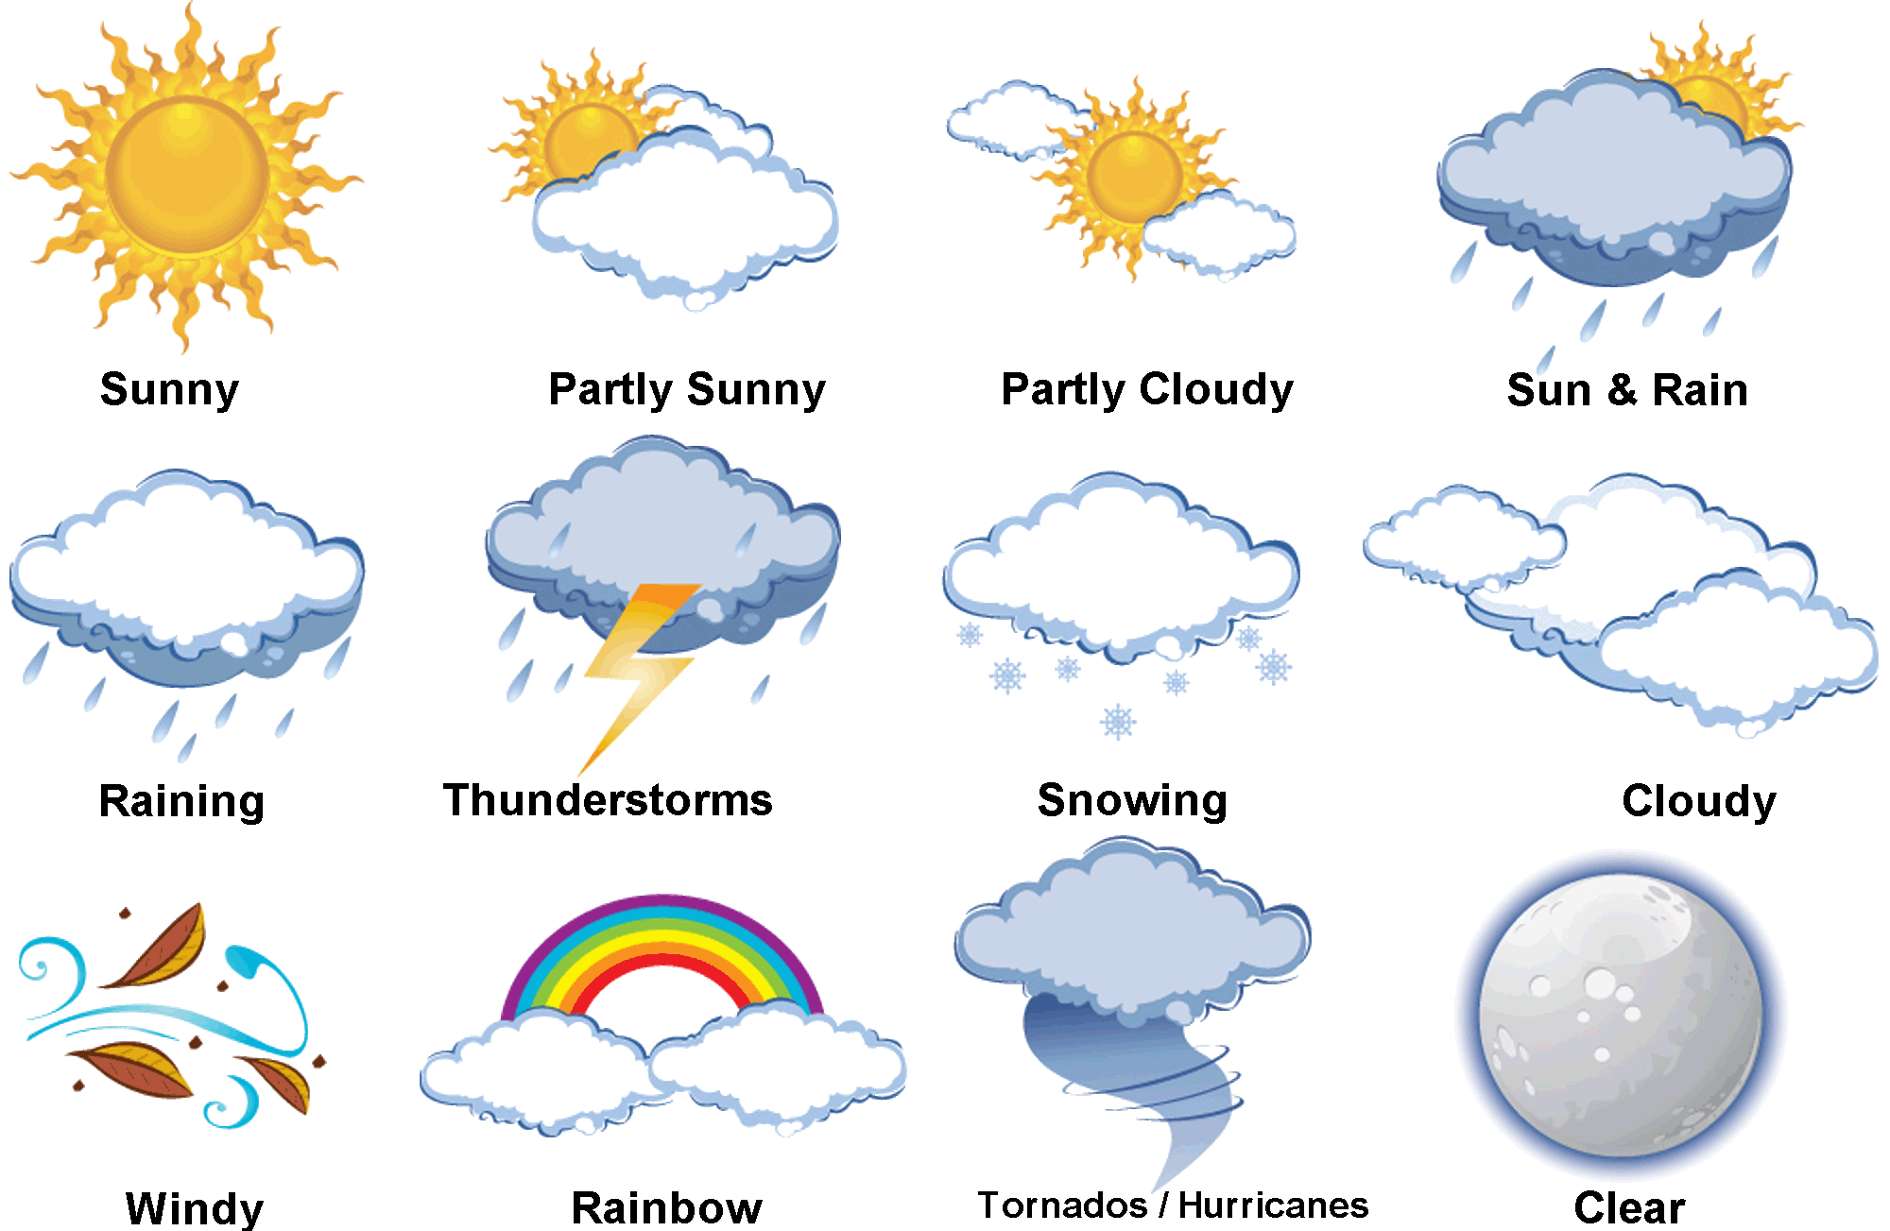
Types of Weather

Slide 5
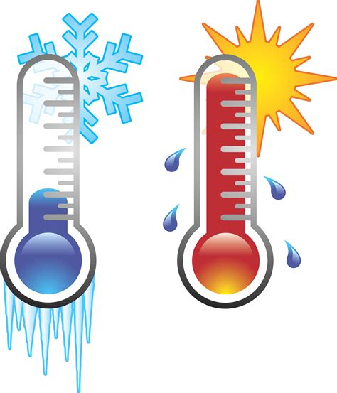
Temperature
Sri Lanka mostly only gets hot or very hot
Also, there is Wet Heat and Dry Heat
These depend on how much water is in the air

Slide 6
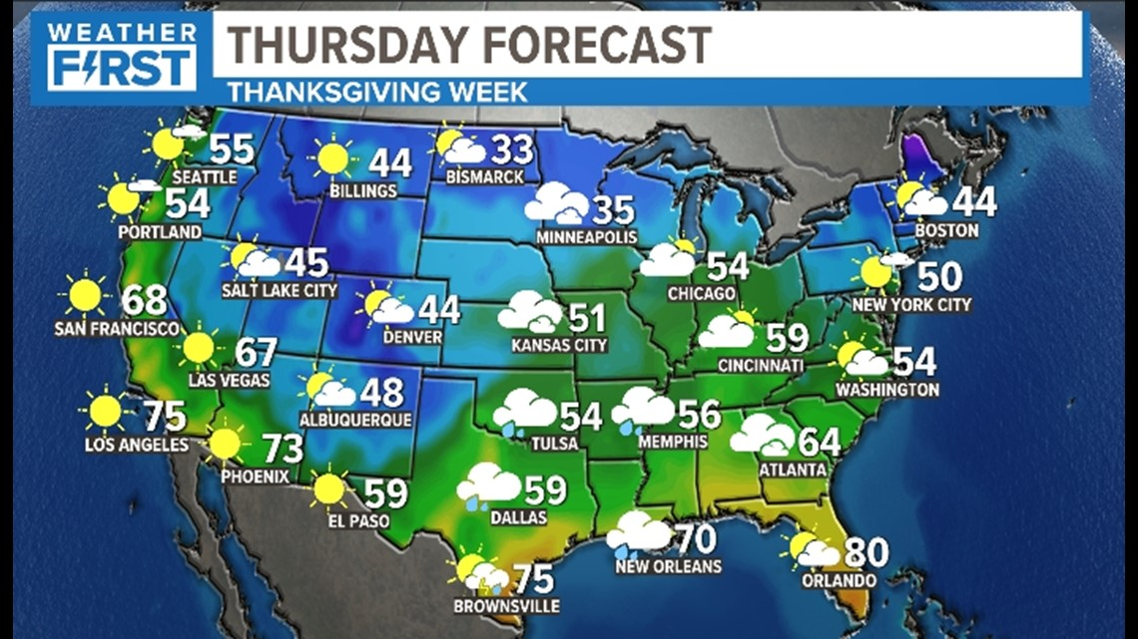
Weather News Reading Activity

Slide 7
What kind of weather do you like?

Slide 8
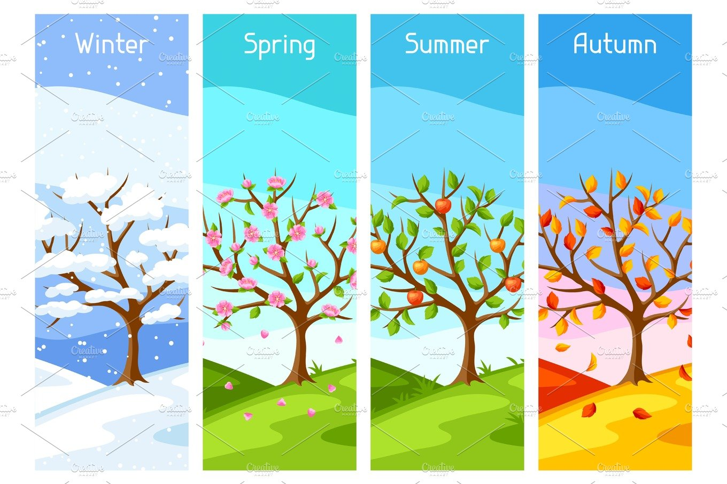

Slide 9
When are your seasons?
Seasons are different in different parts of the world.

Slide 10
Kahoot!
https://create.kahoot.it/details/8fd391ed-033d-4da2-bf17-79a806789472

